Slide 1
UNIX Introduction

Slide 2


UNIX History (1)
Before Multics there was chaos, and afterwards, too
  Multics:
    Multiplexed information and Computing Service
    1965 ~ 1969
    Bell labs, GE, MIT
    Ken Thompson, Dennis Ritchie

Slide 3
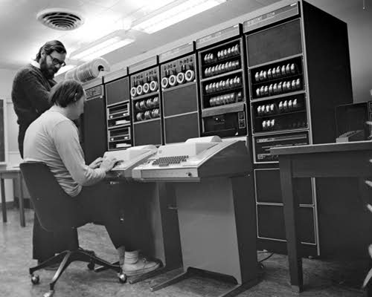
UNIX History (2)
From Multics to something else
  Ken Thompson first written a game called “Space Travel” on Multics on GE machine in 1969.
  Implement “Space Travel” on PDP-7 again.
  Thompson began to design the shell, the editor and the assembler on PDP-7.
  In 1970, Brian Kernighan suggested the name “UNIX”.

Slide 4
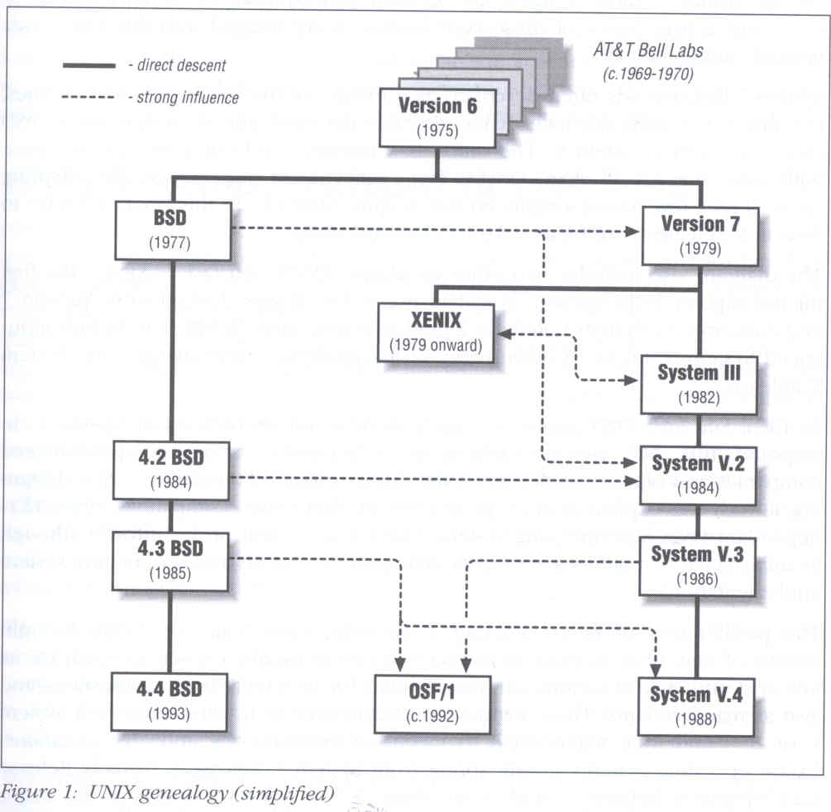
UNIX genealogy
AT&T
  Version 7~10
  System III ~ V
UCB
  BSD
IBM、DEC、HP
  OSF/1

Slide 5
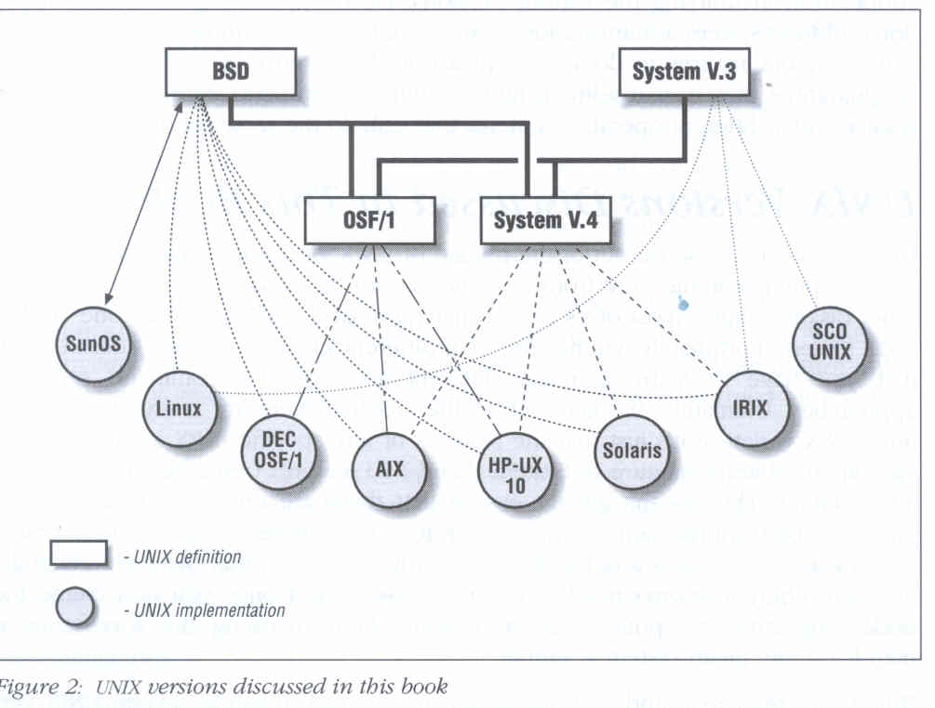
UNIX versions

Slide 6
Conventions
Syntax of commands:
  Anything between “[” & “]” – are optional.
  Anything followed by “…” – can be repeated.
  {a | b} – you should choose one of them.
  Example:
    bork [-x] { on | off } filename …
    bork on /etc/hosts ○
    bork –x /etc/hosts /etc/passwd ○
    bork –x /etc/hosts Ｘ
    bork -h /etc/hosts Ｘ
Globing characters
  “*” matches zero or more characters.
  “?” match one character.
  “~” means home directory
  “~user” means home directory of user

Slide 7
man pages (manual)
man pages (manual)
  Contain descriptions of
    Individual command.
      % man cp
    File format.
      % man rc.local
    Library routines.
      % man strcpy

Slide 8
man command
Command
  % man [-s section] title (AT&T)
  % man [section] title (BSD)
    % man printf (bash printf command)
    % man 3 printf (C Standard printf func.)
    % man –k exit (keyword search)
Man pages organization
%man man
AT&T | BSD | Contents
1 | 1 | User-Level commands and applications
2 | 2 | System calls and kernel error code
3 | 3 | Library calls
4 | 5 | Standard file format
5 | 7 | Miscellaneous files and documents
6 | 6 | Games and demonstrations
7 | 4 | Device Drivers and network protocols
1m | 8 | System administration commands
9 | 9 | Obscure kernel specs and interfaces

Slide 9
UNIX Concepts - ID
User ID, Group ID
  % id chwong
    uid=13029(chwong) gid=200(dcp) groups=200(dcp), 800(security), 700(ta)
  % id 13029
    uid=13029(chwong) gid=200(dcp) groups=200(dcp), 800(security), 700(ta)
Super user
  root
    uid=0(root) gid=0(wheel) groups=0(wheel), …
Other Important Users
  daemon: owner of unprivileged software
  bin: owner of system commands
  sys: owner of the kernel and memory images
  nobody: owner of nothing

Slide 10
UNIX Concepts - Files
% ls –l
  d rwx--x--x 12 chwong dcp 1024 Sep 12 16:47 public_html/
File type
File access mode
# of inodes
File user owner
File group owner
File size
File last modify time
File name

Slide 11
UNIX Concepts - File types
symbol | File types
b | Block device file
c | Character device file
d | Directory
l | symbolic Link
s | Socket
p | named Pipe
- | Regular file
File types
file command
  determine file type
    % file .tcshrc ➔ .tcshrc: ASCII text
    % file /bin ➔ /bin: directory
    % file /bin/sh ➔ /bin/sh: ELF 32-bit LSB executable, Intel 80386, version 1 (FreeBSD), dynamically linked (uses shared libs), stripped
  /usr/share/misc/magic

Slide 12
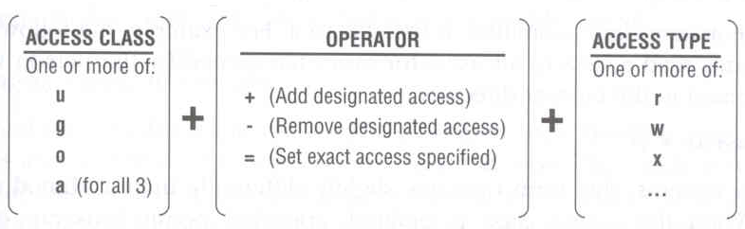
UNIX Concepts - File Access Mode
rwx r-x r-x
  User, group, other privileges
chmod command
  % chmod access-string file
    % chmod u+x test.sh
    % chmod go-w .tcshrc
    % chmod u+w,r-w hehe haha
    % chmod –R 755 public_html/

Slide 13
UNIX Concepts - File Protection
Command | Minimum Access Needed
 | On file itself | On directory file is in
cd /home/test |  | x
ls /home/test/*.c |  | r
ls –s /home/test/*.c |  | rx
cat runme | r | x
cat >> runme | w | x
run-binary | x | x
run-script | rx | x
rm rumme |  | wx

Slide 14
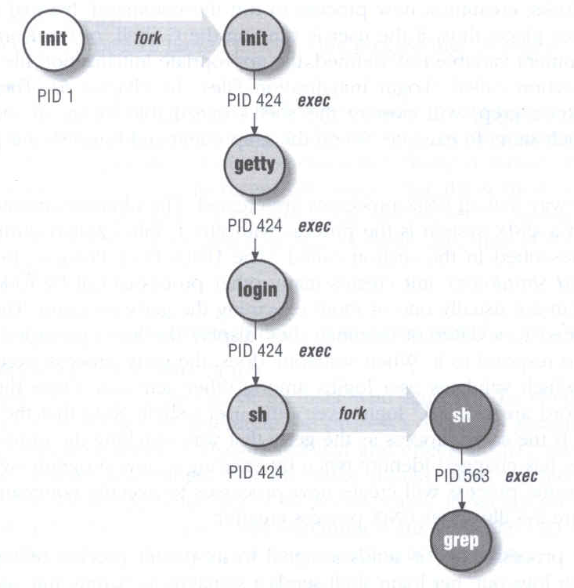
UNIX Concepts - Process
Process: A working program
  foreground
    remain attached to the terminal
  background
    can not communicate with terminal
Process Life Cycle
  fork, exec

Slide 15
UNIX Concepts - Watching Process
ps command
  ps –aux, ps –auxww
    USER, PID, %CPU, %MEM, VSZ RSS, TTY, STAT, START, TIME, COMMAND
      D: in Disk
      I: Idle
      R: Running
      S: Sleeping
      T: sTopped
      Z: Zombie
      man ps…
USER PID %CPU %MEM VSZ RSS TT STAT STARTED TIME COMMAND
root 0 0.0 0.0 0 0 ?? WLs 30Jul06 0:00.01 [swapper]
chwong 83736 0.0 0.5 1416 812 p4 R+ 2:30PM 0:00.00 ps auxww

Slide 16
UNIX Concepts - Kill Process
kill command
  % kill –[signal_name] pid
  % kill –[signal_number] pid
    % kill –HUP 88192 (hang up, reset)
    % kill -1 88192
    % kill –TERM 12345 (software termination)
    % kill –15 12345
    % kill –KILL 3456 (kill program at OS level)
    % kill -9 3456

